Slide 1
Lumen Bank Card Dispute Intake
Kanit Mann, Zachary Bonagura, Manikandan Sundaram
Notes:
Introduce the team in one line, then frame it: a dispute arrives as text, and the work is turning that text into a cited draft a person can sign.

Slide 2
Agenda
1 The problem
3-4
4 Code decides, the model drafts
10-12
2 The pipeline
5-6
5 Cloud and the evidence
13-15
3 Inputs and rules
7-9
6 What comes next
16
Notes:
Six sections. The first four build the case, the fifth is the evidence: cloud, cost, results. The last is what a pilot would do next.

Slide 3
Problem Statement
A credit card complaint arrives. How should a reviewer handle it?
THE REVIEWER NEEDS
1
The facts, and where they came from
2
What is missing or contradicts
3
A cited draft to approve before a case exists
THE AIM
Turn each complaint into one cited draft a reviewer can approve or deny, and never approve a case on the reviewer’s behalf.
Notes:
The complaint is text. The work is finding the facts, spotting what is missing, and writing something a person can sign. The Aim on screen is the contract for the rest of the deck: we produce one cited draft, a person decides it, and nothing is approved on our word.

Slide 4
How It’s Done Today at Lumen Bank
A reviewer rebuilds each complaint by hand.
1
2
3
4
5
6
7
Open the
case
Read the
statement
Read the
transactions
Read the
merchant
Choose the
policy
Count the
deadline
Cite, draft,
record
BANK API
MERCHANT RECORD
POLICY AND RECORD
which version
which date
which words
Three handoffs where two trained people can reach two different answers.
Notes:
Seven reads, three handoffs: the bank API, the merchant record, the policy and the case record. Two trained people can reach two different answers on the same complaint.

Slide 5
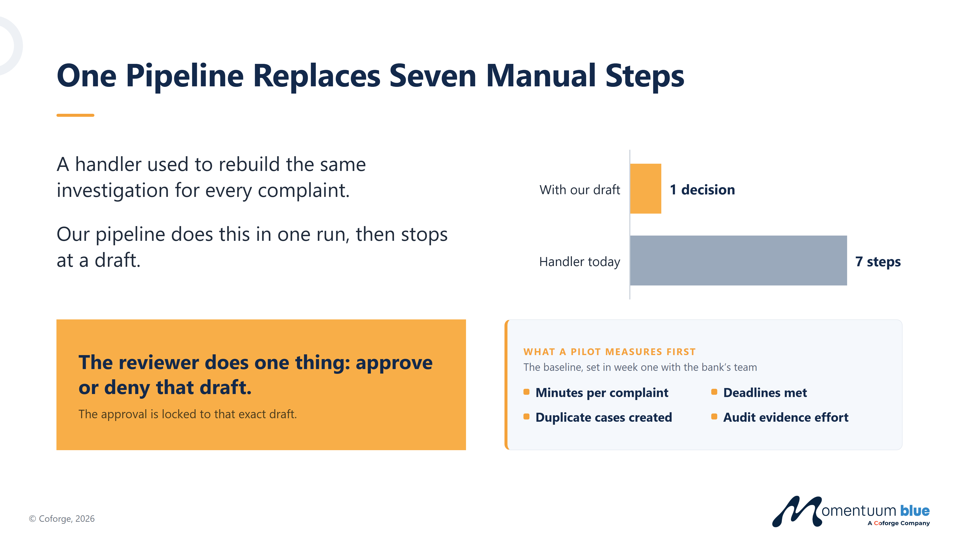
Seven Reads, One Run, Then It Stops at a Draft
A handler used to rebuild this investigation for every complaint. The run does the seven reads. The reviewer still decides.
Open the case
Read the statement
Read the transactions
Read the merchant
Choose the policy
Count the deadline
Cite, draft, record
1
2
3
4
5
6
7
ALL SEVEN READS HAPPEN IN ONE RUN. THEN THE RUN STOPS.
The reviewer's part is one decision: approve, or deny that draft.
The approval binds that exact draft. The gate refuses a changed draft before it writes anything.
Notes:
All seven reads now happen in one run, and the run stops at a draft. The reviewer's part is one decision on that exact draft. If the draft changes, the approval is refused before anything is written.

Slide 6
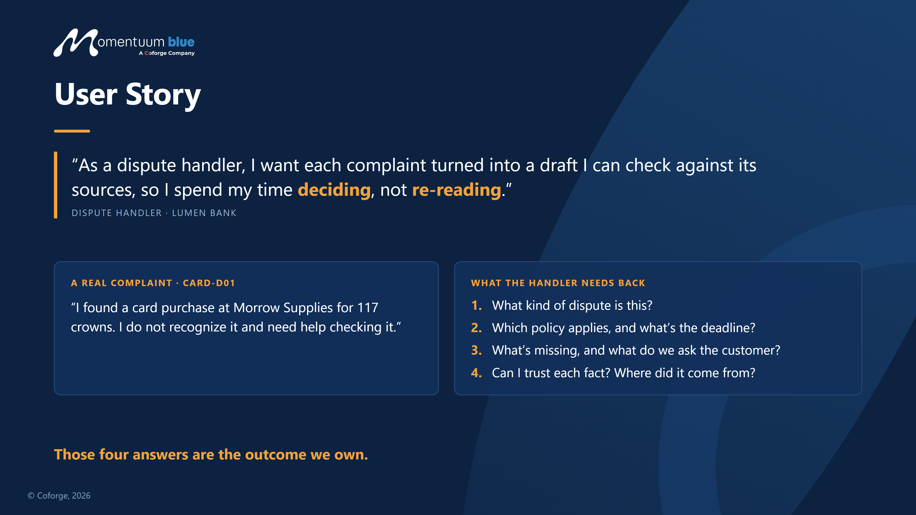
Notes:
This is a real development case, CARD-D01. The handler gets four answers back: the class, the policy and deadline, what is missing, and where each fact came from. Not a chat reply, a draft with a citation on every fact.

Slide 7
Policy Versions and the Procedure
Two versions of the card policy share one procedure. The complaint's reported date picks the version.
DISPUTE TYPE
CARD-POLICY-V1
CARD-POLICY-V2
CARD-PROCEDURE-01
Effective
2026-01-01 to 2026-08-31
2026-09-01 to 2026-12-31
• Recognizes each type of complaint.
• Lists the evidence that type needs.
• Explains the routing logic.
• Constrains the lookups and the failures.
• Stops the system from approving any case.
Unauthorized
20 days
30 days
Duplicate charge
30 days
45 days
Service not received
45 days
60 days
The reported date picks the version, not today's date. D11 reads V1. The other eleven read V2.
Notes:
Two versions of the card policy share one procedure. The version is pinned by the complaint's reported date, never by today's date. Eleven dev cases read V2; D11 reads V1 because it was reported in August.

Slide 8
Intake and the Attachment
One complaint arrives in two pieces. Both are text.
CARD-D01-INTAKE
CARD-D01-ATTACHMENT
Statement: "I found a card purchase at Morrow Supplies for 117 crowns. I do not recognize it."
Merchant: Morrow Supplies
Purchase reference: ORDER-D01
Reported date: 2026-10-01
Amount: 117 XCR
Transaction ID: TX-D01
Received as: plain text, no markup
Customer reference: CUST-D01
Authorization: denied
The words "117 crowns" and the field "117 XCR" are the same currency, one spoken by the customer, one by the bank.
Promised service date: 2026-08-20
Purchase receipt: attached
Submission reference: dispute-d01
NEITHER PIECE CAN GIVE AN INSTRUCTION. TEXT THAT LOOKS LIKE AN ORDER IS READ AS EVIDENCE.
Notes:
One complaint arrives in two pieces, and both are text. The customer says 117 crowns, the bank records 117 XCR: same currency, one spoken and one coded. Neither piece can give an instruction. Text that looks like an order is read as evidence.

Slide 9
5 Buckets, 3 Routes
Buckets
Routes
Unauthorized
Ready For Review
Ambiguous
Duplicate Charge
Manual Review
Unsupported
Service Not Received
Request Information
Notes:
Five classes in, three routes out. The label does not pick the route: the checks do. D05 and D06 go to a person by design, not because anything failed. I can show the counts per route if anyone asks.

Slide 10
Code Decides. The Model Answers the Rest.
CODE
MODEL
PERSON
1 CAPTURE
2 CHECK IN CODE
3 DRAFT, THEN A PERSON
Intake input
DETERMINISTIC CHECKS
Seven checks before any model call
Build the cited draft
Parse into one record
PERSON
approve or deny that exact draft
A rule
matched?
Pin the policy version by reported date
yes
Record the case
no
Append transaction and merchant evidence
MODEL CALL: which of six labels?
Only when no rule matches. Off by default: 0 calls in the published run.
One record per approval. A changed draft is refused.
Notes:
Capture, check in code, then draft and review. Blue is code, orange is the single model call, white is a person. A clear match goes straight to a draft; only the unclear cases reach the model.

Slide 11
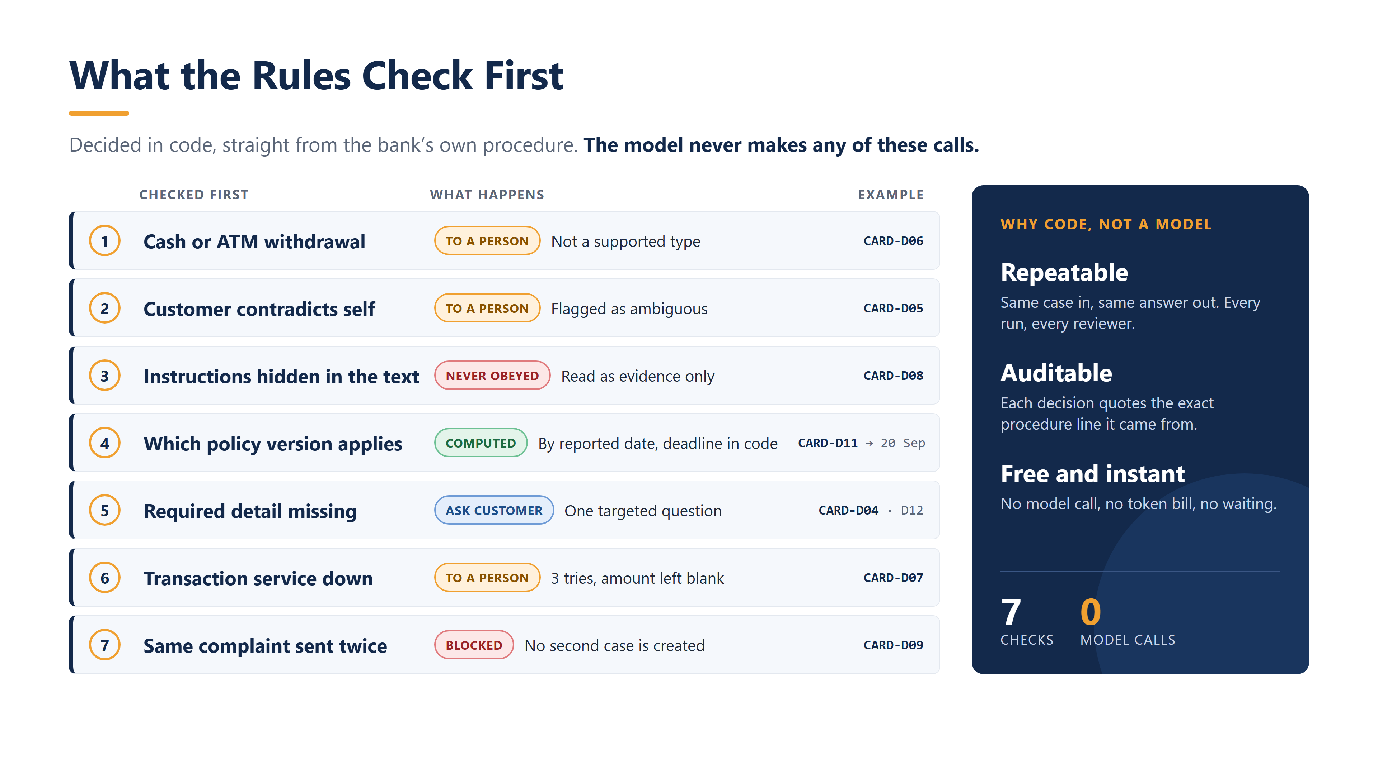
Notes:
Seven checks run before any model call. Each one is code, and each one quotes the procedure line it came from. On the twelve dev cases these fire zero model calls.

Slide 12
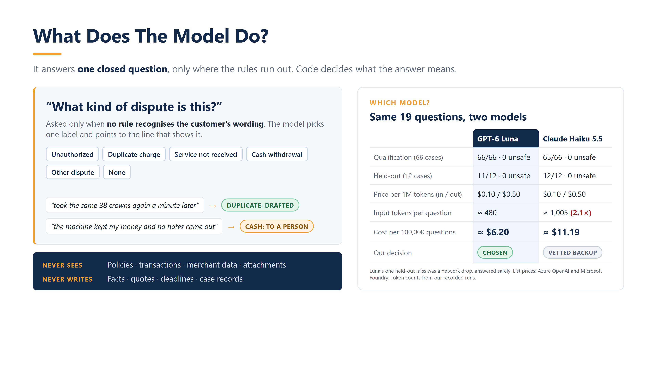
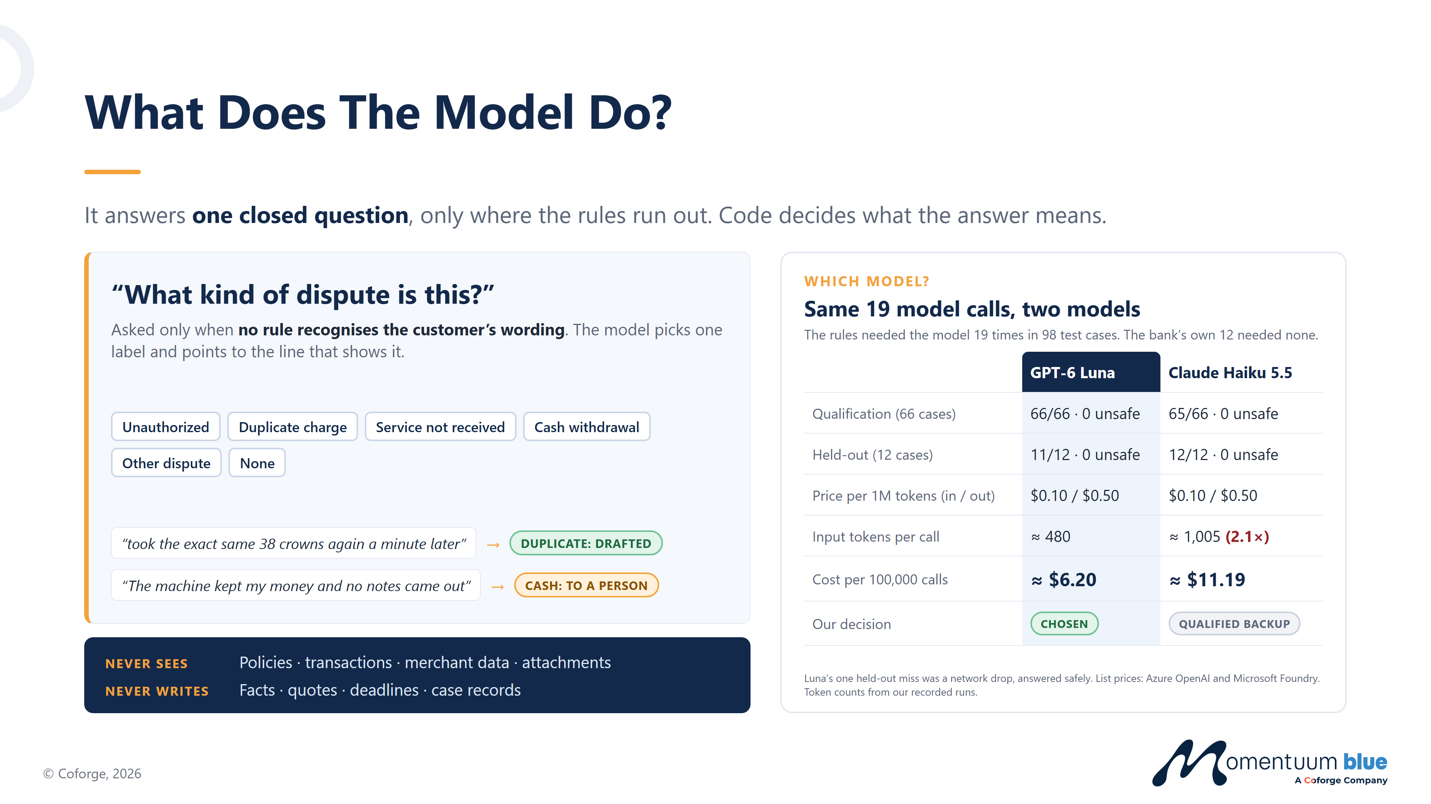
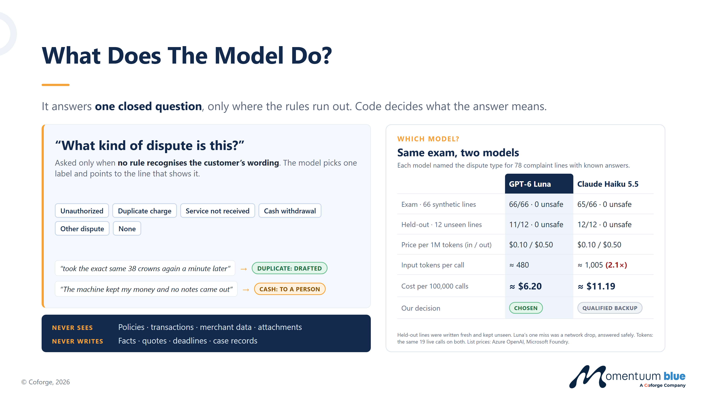

Notes:
One closed question, asked only where the rules run out. On the 66-line qualification set Luna scored 66 and Haiku 65; on twelve held-out lines, 11 and 12. Luna is chosen on cost: 6.20 against 11.19 per hundred thousand calls.

Slide 13
What the Pilot Deploys
One container, one load balancer, one database file. Nothing else exists.
REVIEWER
browser or curl, no account
LOAD BALANCER
public :80, one health route
THE GATE
a person approves the exact draft
ECS FARGATE, ONE TASK
0.5 vCPU, 1 GB
GET /health, /v1/cases
POST /v1/reviews, /v1/records
KYC writes refused in code
STATE: ONE FILE
single writer, 5 tables
OPERATOR
SSM session, audited
Approval runs in the same process tree. No HTTP route reaches a model.
IMAGE 344 MB
CERTIFICATIONS AND ATTESTATIONS
CLOUDWATCH, 7 days
SOC 2
ISO/IEC 27001
SECURITY
SCALE
ISO/IEC 27017
ISO/IEC 27018
MODEL ROUTE
built, off by default, 0 calls
OFF
RECOVERY
PCI DSS Level 1
CSA STAR
DATA GOVERNANCE
Notes:
This is up in us-east-1 now, from the Terraform in the repo: one container, one load balancer, one public address, SQLite on a single writer. It is reachable only from an allowlisted address, so a changed laptop address locks you out until the rule is updated. Approval runs inside the same process, and no HTTP route reaches a model. Deliberately not built: a NAT gateway, RDS, a domain, WAF, S3. For the business side: AWS holds the certificates on that strip, the bank keeps the data and the keys, and this application still needs its own PCI scope.

Slide 14
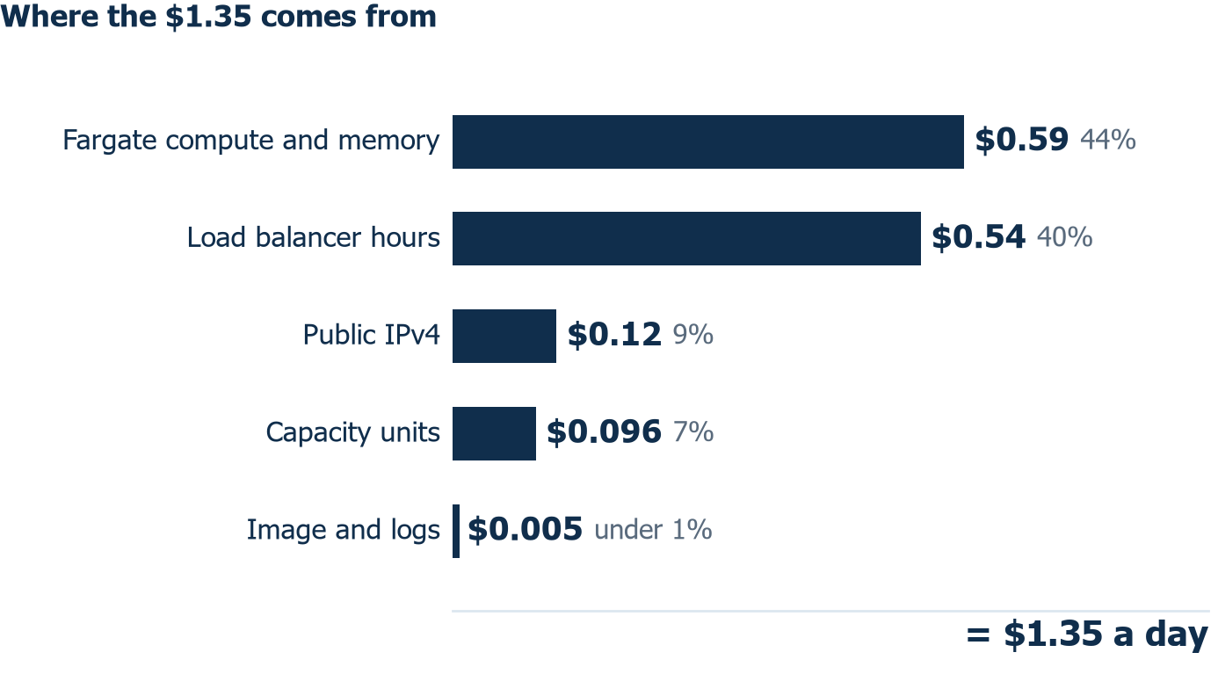
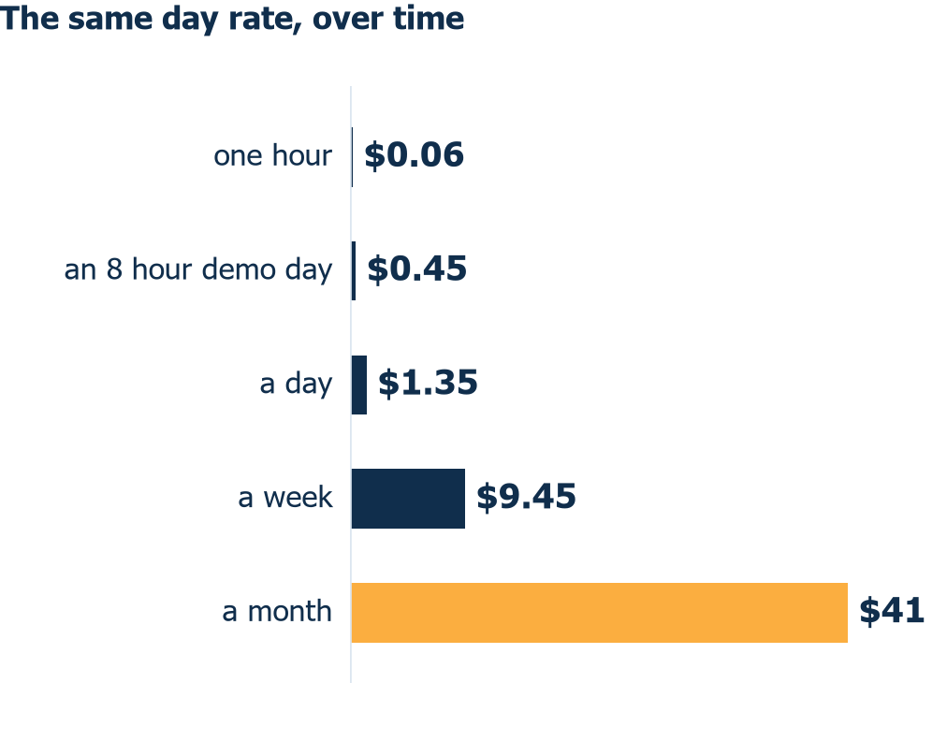
$0.45 a demo day. $41 a month left running
PRICE LIST READ 28 OCTOBER. THE STACK IS UP AT $0.056 AN HOUR. TEARDOWN IS ONE COMMAND, ABOUT THREE MINUTES.
Not created on purpose: NAT gateway ($32.85 a month), RDS, domain and certificate, WAF, S3. Production target at 10k cases a month: $184 to $213, a different estate.
Notes:
1.35 USD a day on the us-east-1 price list, read on 28 October. Fargate and the load balancer are 84 percent of it. The stack went up on 28 October at about five in the afternoon, so it has cost under a dollar so far, at 0.056 an hour. A demo day is 45 cents; leaving it a month is 41 dollars. The exit is one command and takes about three minutes.

Slide 15
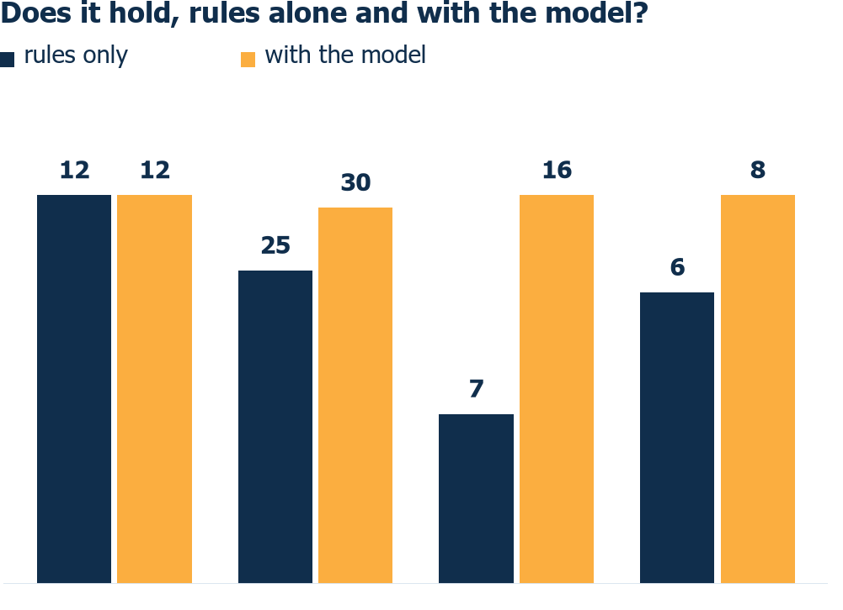
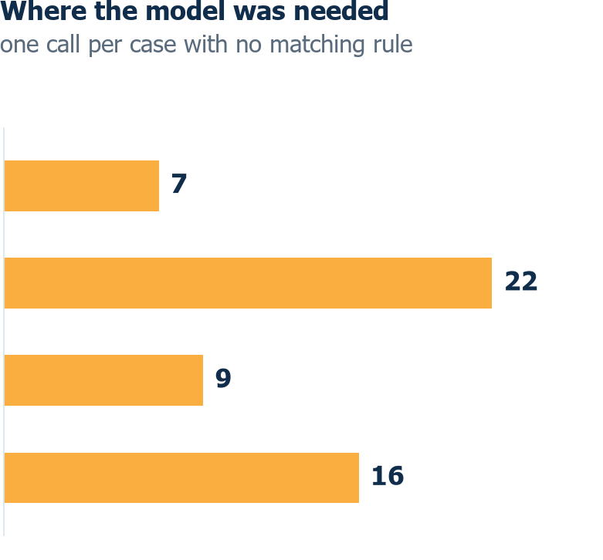
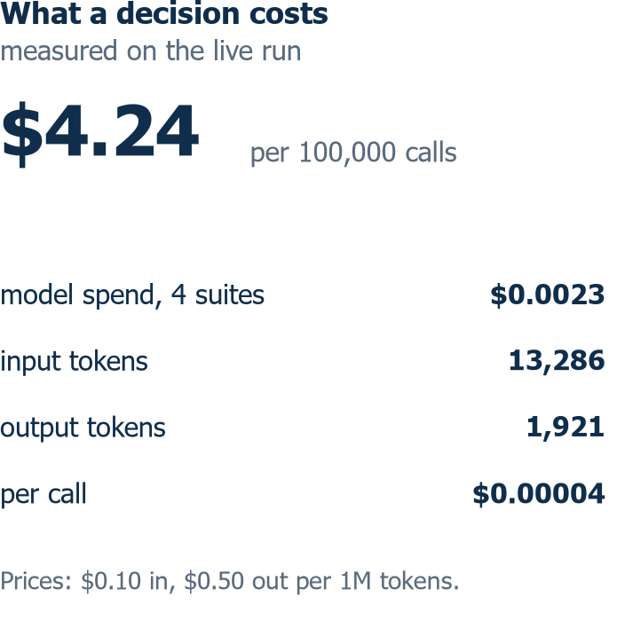
Against the Aim, and Against the Numbers
THE AIM: one cited draft per complaint, a person approves it, no case is created on the machine’s word.
The model lifts the unseen sets: stress 7 of 16 to 16 of 16, held out 6 of 8 to 8 of 8.
The model runs only where a rule found nothing: 54 calls over 67 cases.
One miss left, SYN-S26. Four suites, 54 calls, $0.0023 of model spend.
reports/scored-run-hybrid.json at commit e4368df, 29 October 2026 | model azure_openai/gpt-6-luna | 1,014 tests, 100.00% of 3,404 statements.
Notes:
Back to the aim, then the live run with the model on. Rules alone pass development, and they fall off exactly where you would expect: seven of sixteen on the adversarial set. With the model on, stress goes to sixteen of sixteen and held out to eight of eight. The model is asked only where no rule matched, so it made 54 calls over 67 cases. One miss is left, SYN-S26. Model spend was 0.0023 dollars for the whole run, which is 4.24 dollars per hundred thousand decisions. 1014 tests, 100 percent of 3404 statements. IF ASKED ABOUT TOKENS: 13286 in and 1921 out across the 54 calls. The customer does not need that number.

Slide 16
Built, Switched Off, and What a Pilot Would Measure
RUNNING NOW
Seven checks in code. A gate that refuses a changed draft. A block on a repeated complaint. The retry ladder. One container with SQLite. No account.
NEXT, IN ORDER
Reviewer identity first. The gate binds a hash, not a person. Then the model route on by default, after one measured run and a recorded approval. Then the wrapped statement line. Update and close stay blocked by Gate U.
THE PILOT
Two analysts, 30 days, the bank’s own intake. The first deliverable is a baseline, not a saving. It measures minutes per complaint, deadlines met, duplicate cases and audit effort. Not deployed: one loopback container and a documented Fargate target at about $1.35 a day.
THE DETERMINISTIC UPGRADE
Lumen Bank already sorts its own disputes. If they expose that as an endpoint, code asks the bank. Where the bank has no code, the customer is asked. No model is needed.
Blocked outside us: branch protection, the GitHub plan returns 403.
Notes:
Running now, next in order, and what a pilot would measure. The one thing blocked outside us is branch protection: the GitHub plan returns 403.

Slide 17
Questions?
Notes:
Invite questions. The short answer to most of them is the evidence slide: all four suites measured, the model on, and every miss goes to a person.

